Slide 1
Types of Joint
Some products cannot be manufactured as a single piece, in such cases metal fabrication is done which involves joining of two metals together.
Based on the type of joint produced joining processes can be classified as
Temporary Joint.
Permanent Joint.
Notes:
Based on the process used for making the joint, the joining processes can be further classified as

Slide 2
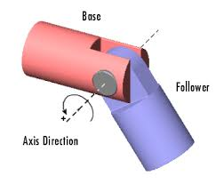
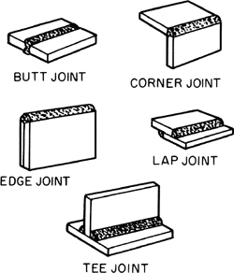
Joining Process
Rigid Joints
Kinetic Joints
Welding, Soldering, Brazing, Revitted, bolted
Notes:
Based on the process used for making the joint, the joining processes can be further classified as

Slide 3
SOLDERING
Soldering is a method of joining similar or dissimilar metals by the application of heat and using a filler metal or alloy called solder.
The molten filler metal is made to flow between the two closely placed adjacent surfaces by the capillary action.
Soldering mainly requires the following-
1. Soldering Iron 2. Solder (alloy)
3. Flux
Notes:
Soldering is a method of joining similar or dissimilar metals by the application of heat and using a filler metal whos temp is below 450 deg C or alloy called solder.
Capillary action – drawing of liquid into interstices ( small space) due to surface tension.

Slide 4
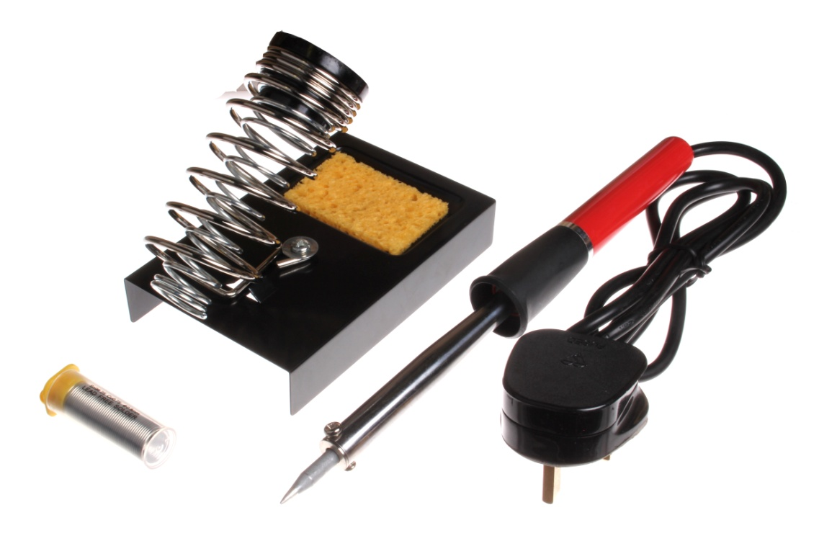
Soldering Process
Soldering gun
Filler material
Flux

Slide 5
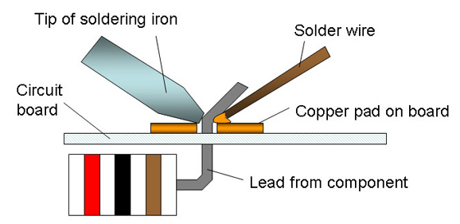
Soldering Process
Notes:
When hot solder comes in contact with copper surface a metal solvent action take place
The solder desolves and penetrates copper surface
The molecules of solder and copper blend together to form new metal alloy

Slide 6
Soldering Procedure
Work Preparation
Work pieces should be perfectly clean.
There should be no dirt, dust, rust, paint or grease.
Cleaning can be done with a file or sandpaper.
Fluxing
Flux depends on the material of work piece.
It is applied with the help of brush.
It avoids oxidation of molten metal, helps in flow of solder

Slide 7
Soldering Procedure
Tinning
Soldering bit is cleaned; application of flux is done over it.
It is brought in contact of solder wire so the bit carriers sufficient amount of molten solder over it.
Filling the joint with molten solder and allow to solidify

Slide 8
Classification of Solders
The solders can be classified into
Soft Solders (Temperature of melting 150 ˚C to 190 ˚C)
Generally composed of lead and tin
ii. Hard Solders (Temperature of melting 300 ˚C to 600 ˚C)
Generally composed of Copper and zinc (4:1)
Notes:
Soft solder - lead 37% tin 63%
Medium solder - lead 50% tin 50%
Plumber’s solder - lead 70% tin 30%
Electrician’s solder - lead 58% tin 42%
Soldering is classified into soft soldering and hard soldering.
Soft soldering is used extensively in sheet metal work for joining parts that are not exposed to the action of high temperatures and are not subjected to excessive loads and forces or vibrations. Soft soldering is also employed for joining wires and small parts. The solder is mostly composed of lead and tin. In soft soldering, Zinc chloride and ammonium chloride are the most common soldering fluxes used which are quick acting and produce efficient joints. But because of their corrosive nature the joint should thoroughly cleaned of all the flux residue from the joint. These are to be used only for non-electrical soldering work. Rosin and rosin plus alcohol based fluxes are least active type and are generally used for electrical soldering work.
Hard soldering employs solder which melts at higher temperatures ( 600 C to 900 C) is stronger than used in soft soldering. Hard solder is an alloy of copper and zinc to which silver is added some times. German silver, used as a hard solder for steel is an alloy of copper, zinc and nickel.

Slide 9
Fluxes
The main function of fluxes are
a. Remove oxide films from base part surfaces
b. Prevent oxidation during heating
c. Promote wetting of the faying surfaces
Faying surfaces are surfaces where parts are joined together with adhesion or welding.
Notes:
Adhesion : ability of a material to stick to an unlike substance

Slide 10
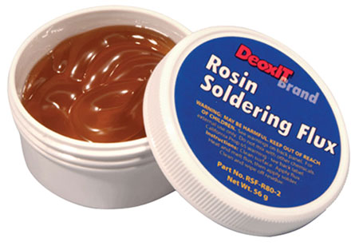
Classification of Fluxes
Types of Fluxes
Organic Fluxes
Chemically unstable at higher temperature but non corrosive at room temperature
Lactic acid, Benzoic acid, Stearic acid are used as flux
Inorganic Fluxes
Inorganic flux consists of mixture of zinc chloride and ammonia chloride
Non Corrosive Fluxes
Rosin fluxes which are non corrosive type fluxes
Rosin is a derivates of pipe trees gum. It is highly electric conductive in nature

Slide 11
Advantages of Soldering
Low cost and easy to use
Soldered joints are easy to repair and rework.
The soldered joint can last for a long time
Leak proof joints can be produced
Low energy is required.

Slide 12
Disadvantages of Soldering
The strength of soldered joints is low.
Cannot be used for high temperature applications
Skilled and trained person is required

Slide 13
Brazing
Brazing is a joining process in which two similar or dissimilar metals joined by a special filler metal whose melting temperature is above 450 ˚C
Components in brazing
Filler Metal (spelter)
Flux
Brazing Torch
Filler metals in brazing
Aluminium – Silicon alloy are generally used for brazing alloys – with melting point 550 ˚C – 780 ˚C
Magnesium filler metals used for brazing magnesium alloys
Notes:
The principal difference is the use of a harder filler material commercially known as spelter.
Filler metals used in this process may be divided into copper base alloys and silver base alloys.
The spelter is usually an alloy of copper, zinc and tin.
Both similar and dissimilar metals can be joined.

Slide 14
Copper and copper zinc alloys and copper tin alloys, melting range is 850 ˚C to 950 ˚C are used for brazing ferrous alloy, Nickel and copper – nickel alloys
Nickel filler alloys are used for brazing Ni and Cobalt – base alloys. Nickel braze joints can stand over 980 ˚C
Copper – Phosphorus alloys are used for brazing copper and its alloys. Melting temperature 700 ˚C – 750 ˚C
Flux
Borax, boric acid, fluorides or chlorides are commonly used flux
Welding Torch
Oxyacetylene welding torch

Slide 15
Comparison between soldering, brazing
Soldering | Brazing
Filler metal is called solder | Filler metal is called spelter
Melting point of filler metal is below 450 ˚C | Melting point of filler metal is above 450 ˚C but below melting point of work piece
Soldered joint strength is low | Brazed joint strength is high
Solder is cheaper process (Economical Process) | Brazing is costlier process
Usually suitable for join metals with small thickness | Suitable process for joining metals for larger thickness

Slide 16
Advantages
Much heat is not involved in the process. Hence low thermal distortions.
Easily automated process
Dissimilar parts can be joined

Slide 17
Disadvantages
Flux residual must be removed after brazing, otherwise which may cause corrosion
Large and thick sections cannot be brazed efficiently
Relatively expensive filler materials

Slide 18
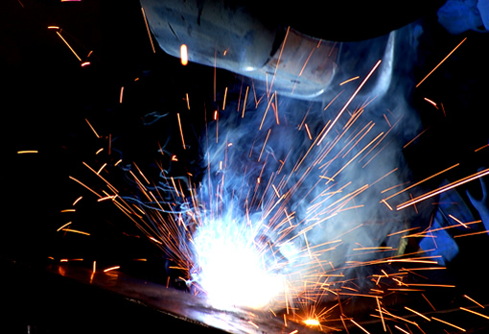
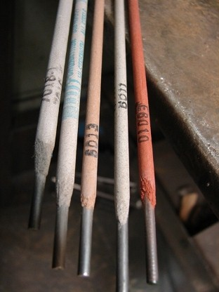
Welding

Slide 19
Welding
Welding is a metallurgical joint of two metals pieces together to produce essentially a single piece of metal.
Notes:
The process is carried out by heating the edges of workpiece to a suitable temperature and then fused together with or without the application of pressure.
Filler metal is used to supply additional material to fill the gap . Welding can also be carried out without filler metal

Slide 20
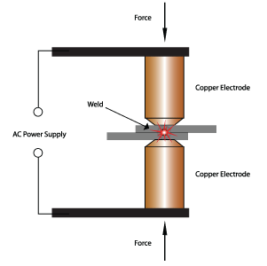
Welding
Classification
Plastic Welding (Pressure welding)
The parts are heated upto plastic state and then fused together by applying the external pressure.
Eg. Resistance welding , forged welding
Fusion Welding
The parts to be joined are heated above their melting temperatures and then allowed to solidify by cooling.
Notes:
Plastic Welding : no filler metal is used in this process
Fusion Welding : filler metal may or may not be used during the welding
Eg: Arc welding, gas welding, Laser welding

Slide 21
Welding
Electric Arc Welding
Notes:
D When two electrically conducting materials comes touched together monetarily and instantaneously spereate slightely. Eventhough it is seperated there will be sufficient voltage to flow of current so arc will be formed.
Arc welding is a fusion welding that utilizes high intensity of arc generated by flow of current to melt the workpiece. A solid continuous joint is produced while upon cooling.
The source of heat for arc welding process is an electric arc generated between two electrically conducting materials: w/p and electrode. AC or DC can be used to supply the required

Slide 22
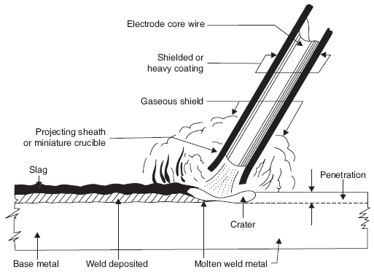
Welding
Operation
Holder holding the electrode forms one pole of the circuit and the parts to be welded forms the other pole.
An arc is struck between electrode and work piece and generates the heat ranges from 5000 ˚C to 6000 ˚C
The arc produces an inert gaseous shield surrounding the arc to protect the molten metal from oxidizing
Arc Length
Notes:
The electrode brought in contact between the workpiece, the the electrode will momentarilly seperated by a distance of 2-4mm an arc can be generated. The electrical energy is converted into heat energy. That heat melts edges of w/p. coalescence takes place where molten metal of one workpiece combines with molten metal of the other metal . It allowed to solidify and two w/p will be joined
Cleaning is done by acetone Or carbon tetrachloride
During the operation the arc will be struck b/n w/p and electrode and electrode seperated by the workpiece but still the arc remains between workpiece and electrode( 5000-6000 deg c)

Slide 23
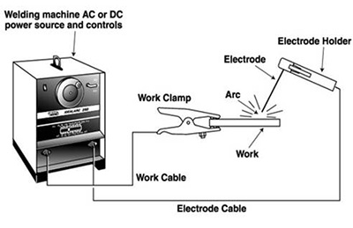
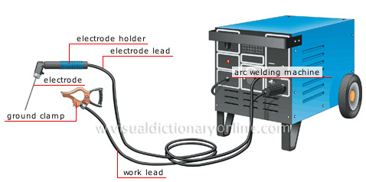
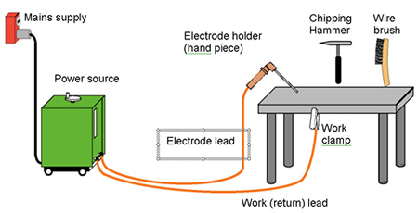
DC
Straight polarity - Negative pole in order to melt greater mass of metal in the base material.
Reversed Polarity – Less metal will be melted in reversed polarity
AC arc welding a step down transformer is used
A high current of 100 A to 400 A will be suitable for general arc welding work
Welding Setup
Notes:
Both Alternating current and direct current are used for arc welding.
AC arc welding Step down transformer is used. The transformer receives the AC supply between 200amp and 440volts and transformer it to the required low voltage in range of 80 to 100 volts. A high current of 100A to 400A will be suitable for general arc welding work.
DC arc welding the workpiece is connected to positive pole and electrode negative pole in order to melt greater mass of metal in the base material. ( these type of setup is called straight polarity).
When less heat is required at the base metal , the polarity is reversed. Polarity is depends upon type of job.

Slide 24
Arc Welding Electrodes
Consumable Electrode
Electrode may be bare or coated
Bare: Globules of molten metal while passing from the electrodes absorb oxygen and nitrogen from the atmospheric air to form non metallic constituents. Which decreases the strength of the joint
Coated Electrode: The protection of molten metal from oxygen and nitrogen of the air by providing a gas shield around the arc and the molten pool of metal
To establish and maintain the arc throughout welding
The formation of slag over the joint thus protects from rapid cooling
The addition of alloying element
The coating is usually consist of Chalk, ferro manganese, Starch, Kaolin, alloying and bending material
Notes:
Tubular – flux inside metal outside
Coated with flux- titanium oxide, cellulose, manganese oxide, calcium carbonates, mica, iron oxide etc., can be used as flux material
Flux coated on electrode performs the following functions.
Stabilization of arc
Prevents oxidation of molten metals
Helps in removal of oxides and other undesirable substances present on the surface of the workpiece
Chemically reacts with oxides and forms slag. Slag floats and covers the top portion of the molten metal there by preventing it from rapid cooling
Eliminates weld metal porosity
Helps to produce minimum spatter adjacent to the weld

Slide 25
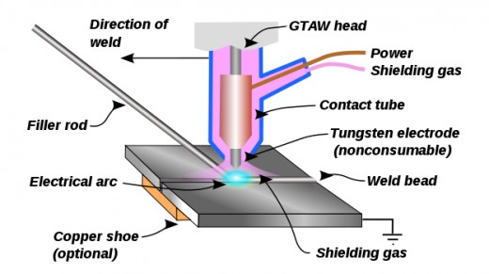
Arc Welding Electrodes
Non Consumable Electrode
Additional filler material is required.
Notes:
An additional filler material is also required. The advantages of using this type is that the amount of the metal deposited by the filler rod can be controlled which is not possible in the other type electrode.
They serves only to strike and maintain the arc during the welding process.
Electrode may be carbon, tungsten , graphite do not consume during welding . It is used only to generate arc during welding

Slide 26
General Arc Welding Procedure
Step 1: Cleaning: The surfaces of the parts to be welded need to be thoroughly cleaned for removal of dirt, oil, grease etc.
Step 2: Edge Preparation: Involves beveling or grooving.
Step 3: Clamping: The parts to be welded are clamped suitably through jigs and fixtures
Step 4: Check for safety devices: Safety devices like goggles and shields to protect the eyes, protective clothing to prevent the sparks and flying globules of molten metal, safety shoes, gloves, aprons and other safety devices must be ensured
Step 5: The Initial weld: Inital tack welds are done at the opposite corners of the joint to secure the pieces together.
Step 6: The Final weld: Final welding is done
Step 7: Excess material removal: Extra material on the weld surface can be removed using tongs and chipper.

Slide 27
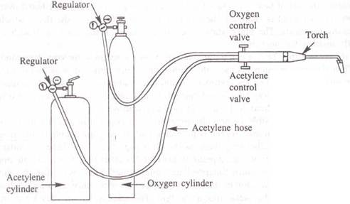
Gas Welding
Gas welding is a fusion welding method of welding, in which a strong gas flame is used to rise the temperature (3200 ˚C) of the work pieces so as to melt them
Gas Welding Setup
Notes:
Aacetylene or hydrogen (2500 deg c)
oxy-acetylene welding –( high flame temp 3500deg c)
GW is a fusion welding process in which the workpieces are joined by the heat of a strong flame generated by the combustion of a fuel gas and oxygen. The fuel gas may be acetylene, hydrogen, propane or butane

Slide 28
Gas Welding Flames
For complete combustion of acetylene 2.5 volume of oxygen are required for 1 volume of acetylene.
2C₂H₂ + 5O₂ → 4CO₂ + 2H₂O
Oxygen to acetylene ratio varies from 0.95 to 1.5.
Depending on oxygen to acetylene gas ratio it can be classified as
Neutral, (<0.95)
Oxidizing (1.15 to 1.5) and
Carburising or reducing flames (0.95 to 1)

Slide 29
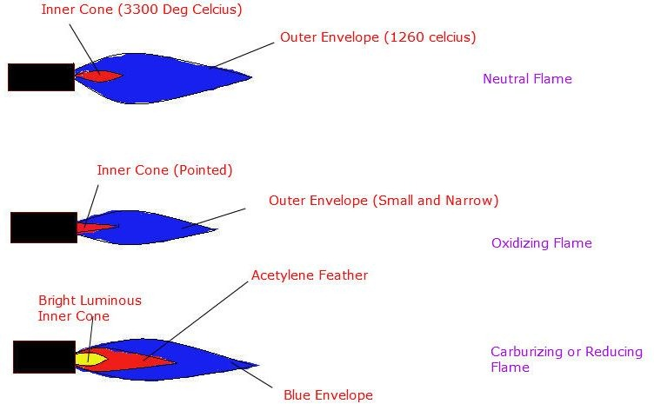
Gas Welding Flames
Notes:
Neutral oxygen and acetylene are mixed in equal proportion
3260
3500
3066
Neutral flame – sharp blue flame is surrounded with white inner cone. Used for welding mild steel, cast iron, aluminum, copper etc and used for metal cutting . It has least chemical effect on the heated metal.
Oxidizing flame – supply of oxygen is more compared to gas fuel. The oxidizing flame appears similar to the neutral flame but with a shorter inner cone, and outer envelope being narrow and brighter in color. It is used for welding copper-base metal, zinc base metals. It is not used for welding steels, as it will oxidize or burn some of the metal being welded.
Reducing flame- rich in acetalyne . Combustion is incomplete unconsumed carbon being present in the flame. Blue envelope is longer than neutral flame, unsumed carbon is present in acetylene feather. It is used to weld hard surfaces ( welding monel Ni-Cu alloys) and few ferrous metals. Welding steel must be avoided because unconsumed carbon may be introduced into the weld to produce a hard and brittle deposite.

Slide 30
Advantages
Process is simple and inexpensive
Eliminates a skilled operator
Temperature of the flame can be controlled depending on the thickness and type of material being welded

Slide 31
Disadvantages
Acetylene gas is slightly costlier
Not suitable for thick and high melting point metals
Refractory metals like tungsten, molybdenum etc., and reactive metals like zirconium, titanium etc., cannot be gas welded.
Acetylene gas is highly explosive. Hence precautions should be taken during its storage and welding.

Slide 32
Brazing | Welding
Filler metal is melted | Surface to joined are melted
No penetration into base metal | There is penetration into the base metal
Relatively weaker joints | Relatively stronger joint
Average operating skill level is required | High operating skill and experience

